Slide 1
7
The Laplace Transform

Slide 2
7.2
Inverse Transforms and Transforms of Derivatives

Slide 3
7.2.1 Inverse Transforms

Slide 4


7.2.1 Inverse Transforms (1 of 4)
The Inverse Problem
If F (s) represents the Laplace transform of a function f (t), that is,
we then say f (t) is the inverse Laplace transform of F(s) and write

Slide 5
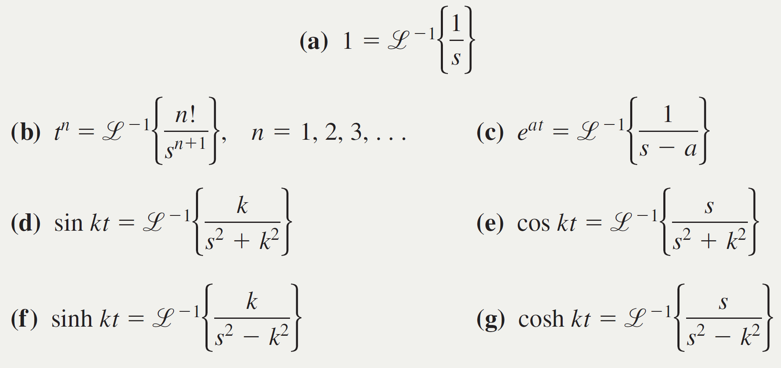
7.2.1 Inverse Transforms (2 of 4)
Theorem 7.2.1 Some Inverse Transforms

Slide 6
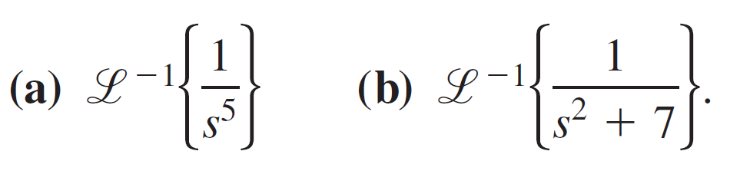

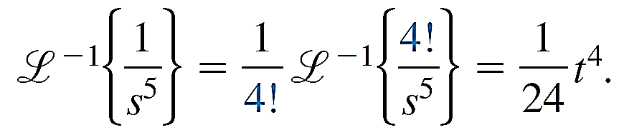
Example 1 – Applying Theorem 7.2.1
Evaluate
Solution:
(a) To match the form given in part (b) of Theorem 7.2.1, we identify n + 1 = 5 or n = 4 and then multiply and divide by

Slide 7
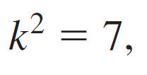


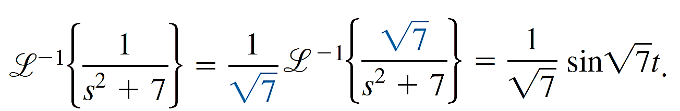
Example 1 – Solution (1 of 1)
(b) To match the form given in part (d) of Theorem 7.2.1, we identify
We fix up the expression by multiplying and dividing by
so

Slide 8

7.2.1 Inverse Transforms (3 of 4)
is a Linear Transform
The inverse Laplace transform is also a linear transform; that is, for constants α and β
where F and G are the transforms of some functions f and g.

Slide 9
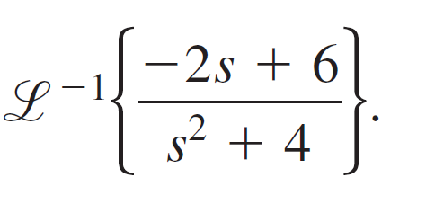
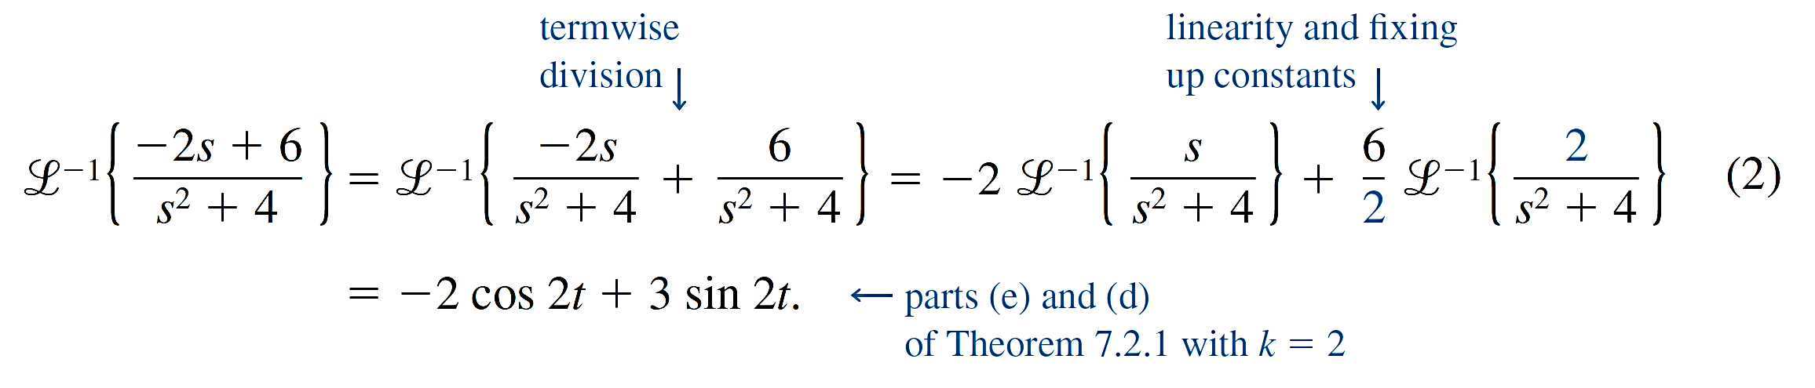
Example 2 – Termwise Division and Linearity
Evaluate
Solution:
We first rewrite the given function of s as two expressions by means of termwise division and then use (1):

Slide 10
7.2.1 Inverse Transforms (4 of 4)
Partial Fractions
Partial fractions play an important role in finding inverse Laplace transforms. The decomposition of a rational expression into component fractions can be done quickly by means of a single command on most computer algebra systems.
The next example illustrates partial fraction decomposition in the case when the denominator of F (s) is factorable into distinct linear factors.

Slide 11
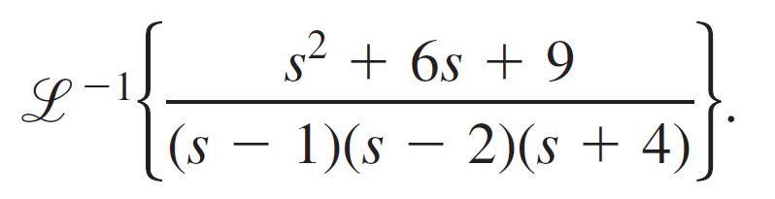
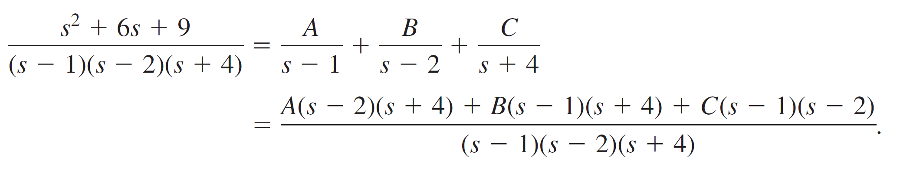
Example 3 – Partial Fractions: Distinct Linear Factors
Evaluate
Solution:
There exist unique real constants A, B, and C so that

Slide 12
Example 3 – Solution (1 of 3)
Since the denominators are identical, the numerators are identical:
By comparing coefficients of powers of s on both sides of the equality, we know that (3) is equivalent to a system of three equations in the three unknowns A, B, and C.

Slide 13
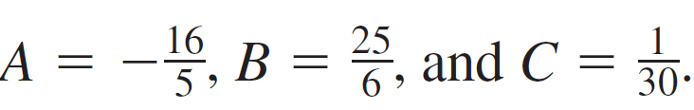
Example 3 – Solution (2 of 3)
However, there is a shortcut for determining these unknowns. If we set s = 1, s = 2, and s = −4 in (3), we obtain, respectively,
16 = A(−1)(5), 25 = B(1)(6), and 1 = C(−5)(−6),
and so

Slide 14
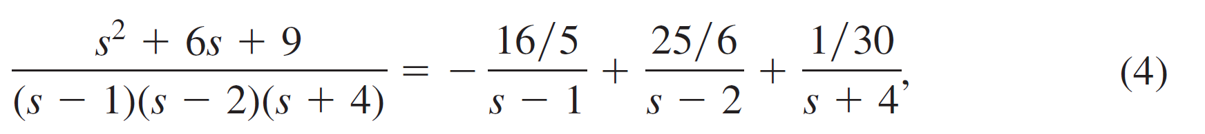

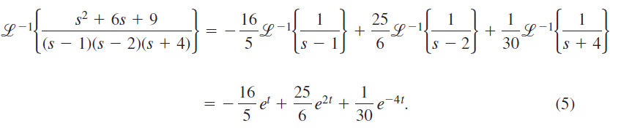
Example 3 – Solution (3 of 3)
Hence the partial fraction decomposition is
and thus, from the linearity of
and part (c) of Theorem 7.2.1,

Slide 15
7.2.2 Transforms of Derivatives

Slide 16




7.2.2 Transforms of Derivatives (1 of 7)
Theorem 7.2.2 Transform of a Derivative
If
are continuous on
and are of exponential order and if
is piecewise continuous on
then
where

Slide 17


7.2.2 Transforms of Derivatives (2 of 7)
Solving Linear O D Es
It is apparent from the general result given in Theorem 7.2.2 that
and the n − 1 derivatives of y(t) evaluated at t = 0.
This property makes the Laplace transform ideally suited for solving linear initial-value problems in which the differential equation has constant coefficients.
depends on

Slide 18

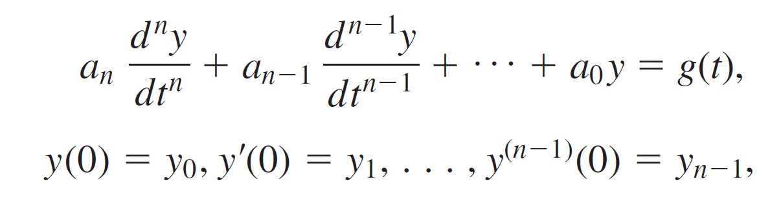
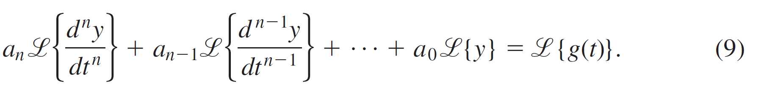
7.2.2 Transforms of Derivatives (3 of 7)
Such a differential equation is simply a linear combination of terms
where the a_{i}, i = 0, 1, ... , n and y₀, y₁, ... , y_{n − 1} are constants. By the linearity property the Laplace transform of this linear combination is a linear combination of Laplace transforms:

Slide 19
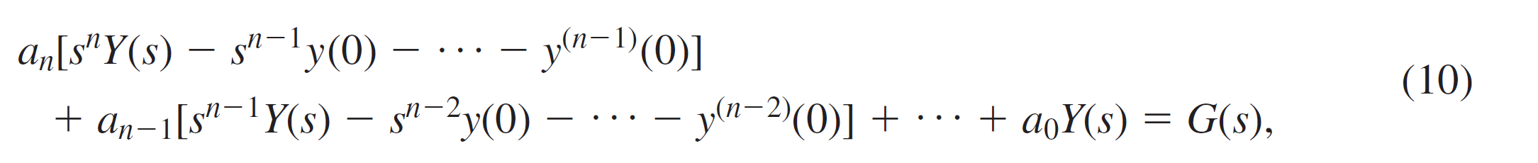
7.2.2 Transforms of Derivatives (4 of 7)
From Theorem 7.2.2, (9) becomes
where
In other words,
The Laplace transform of a linear differential equation with constant coefficients becomes an algebraic equation in Y (s).

Slide 20
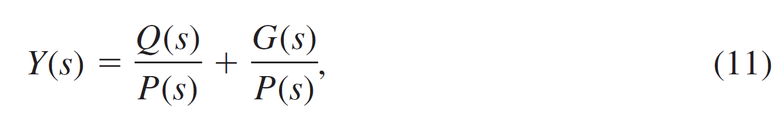

7.2.2 Transforms of Derivatives (5 of 7)
If we solve the general transformed equation (10) for the symbol Y (s), we first obtain P (s)Y (s) = Q (s) + G (s) and then write
where
Q(s) is a polynomial
in s of degree less than or equal to n − 1 consisting of the various products of the coefficients a_{i}, i = 1, ..., n and the prescribed initial conditions y₀, y₁, ..., y_{n − 1}, and G(s) is the Laplace transform of g(t).

Slide 21

7.2.2 Transforms of Derivatives (6 of 7)
Typically, we put the two terms in (11) over the least common denominator and then decompose the expression into two or more partial fractions.
Finally, the solution y (t) of the original initial value problem is
where the inverse transform is done term by term.

Slide 22
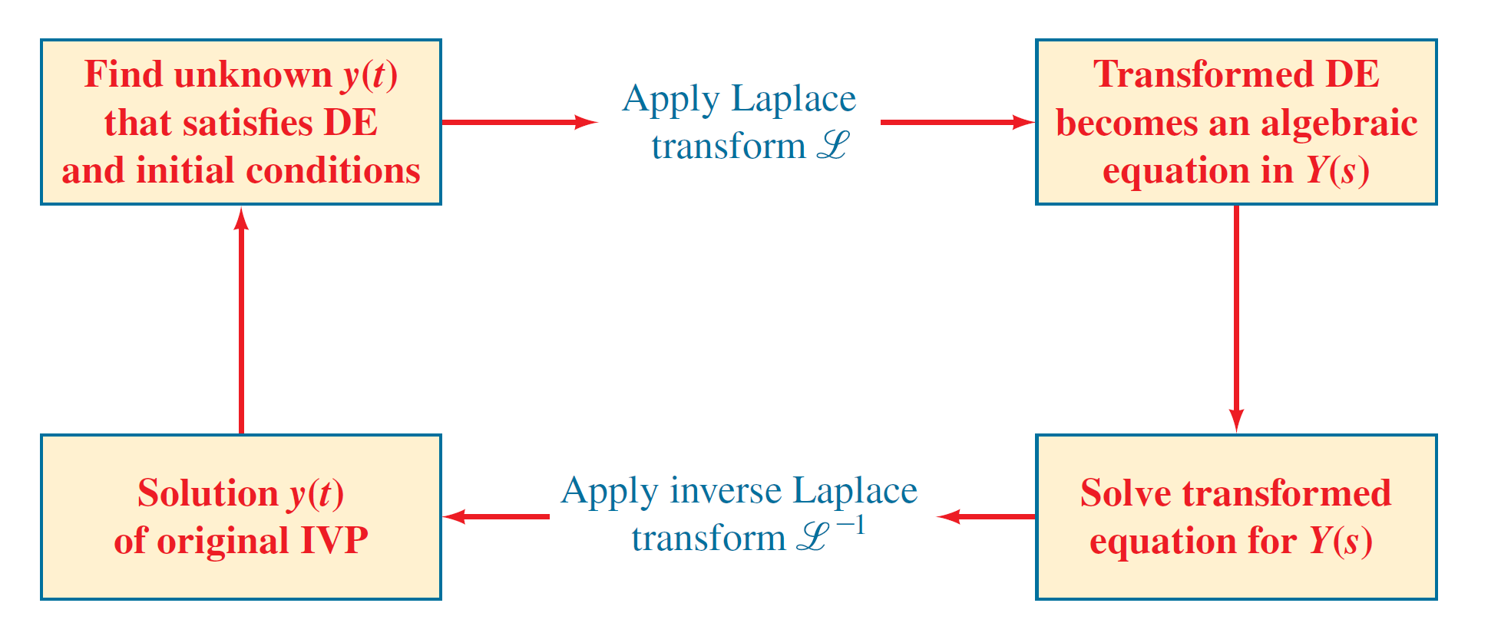
7.2.2 Transforms of Derivatives (7 of 7)
The procedure is summarized in the diagram in figure.
Steps in solving an I V P by the Laplace transform
Figure 7.2.1

Slide 23
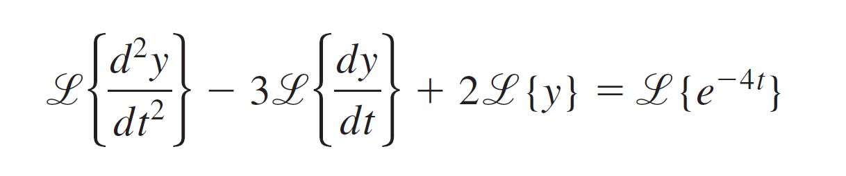
Example 5 – Solving a Second-Order I V P
Solve
Solution:
We take the sum of the transforms of each term, use (6) and (7), use the given initial conditions, use (c) of Theorem 7.1.1, and then solve for Y(s):

Slide 24
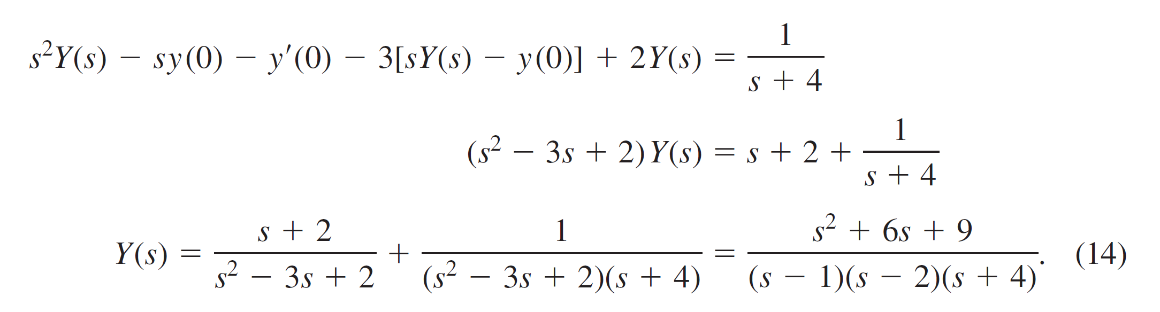
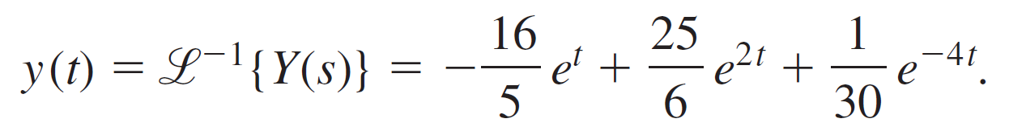
Example 5 – Solution (1 of 1)
The details of the partial fraction decomposition of Y(s) in (14) have already been carried out in Example 3. In view of the results in (4) and (5) we have the solution of the initial-value problem

